Slide 1
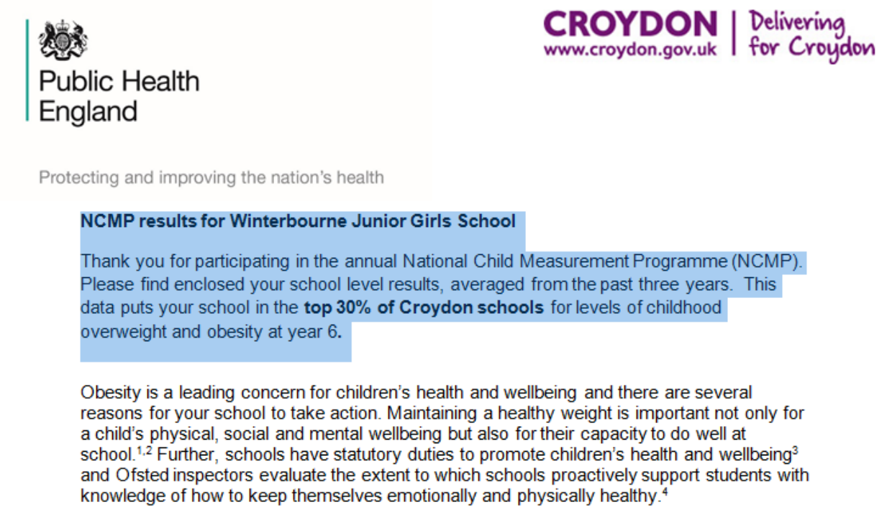
Why????

Slide 2
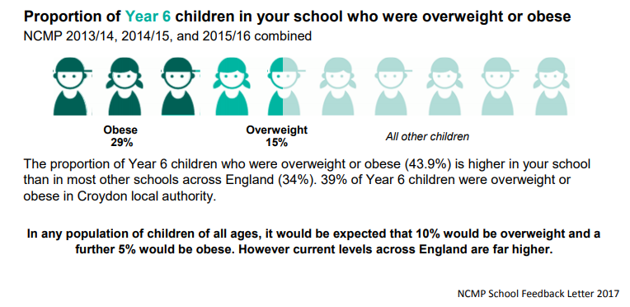
Why????

Slide 3
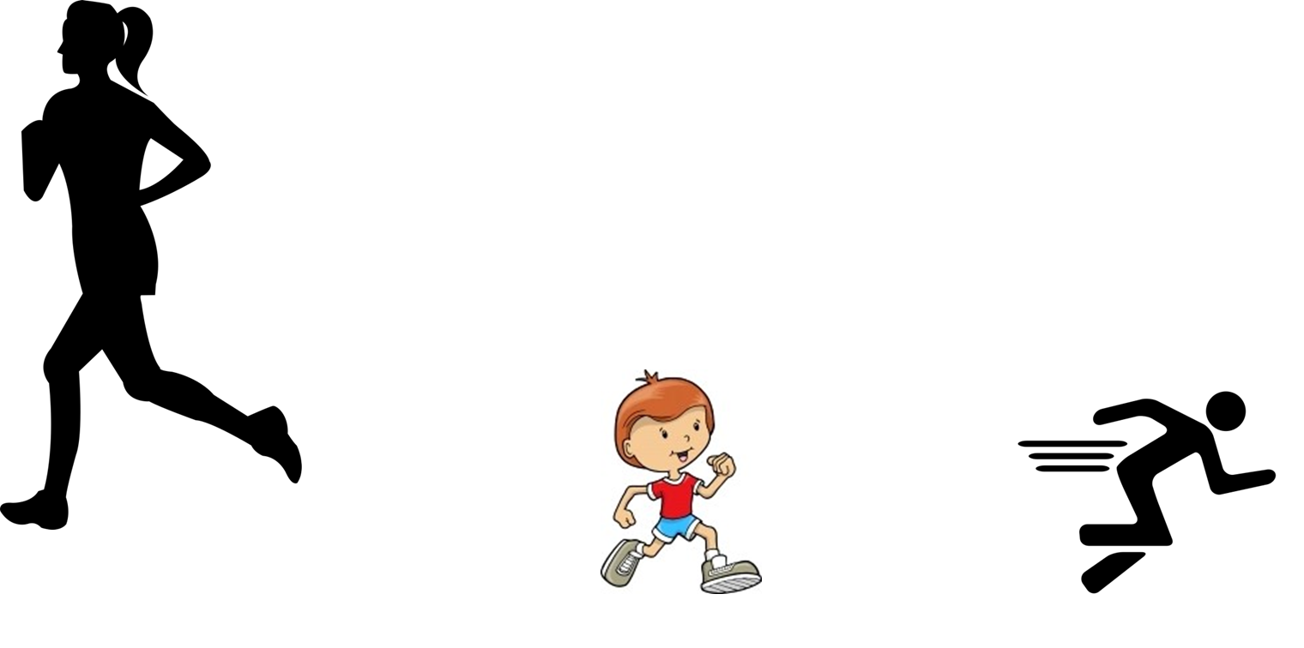
How?
The Daily Mile!!

Slide 4
Scooting the Daily Mile course.
Using the gym equipment.
What...
Jogging, walking, running, skipping or a combination of all of these- with use of pedometers.
Zumba with Ms Gonzalez- on screen.
Hula-hooping and Skipping-with skipping ropes.
Day | 12.15-12.30 | 12.30-12-45 | 12.45-13.00 | 13.00-13.15
Monday | Year 3 | Year 5 | Year 6 | Year 4
Tuesday
Wednesday
Thursday
Friday

